Slide 1


Titolo presentazione sottotitolo
Software Engineering 2
PowerEnJoy Project
Milano, XX mese 20XX
Lo Bianco Riccardo, Manzoni Mirco, Mascellaro Giuseppe
A.A. 2016/2017
Professor Di Nitto Elisabetta

Slide 2
PowerEnJoy
PowerEnJoy is a car sharing service that exclusively employs electric cars.
The company is in need of a system that allows users to find the locations of available cars located in the geographical areas they choose to explore.

Slide 3
Outline
Requirements Analysis
and
Specification Document
Goals
Project Planning
Function Points Analysis
Design Document
Architecture Overview
Proposed system
Actors
Scenario & Use Case
COCOMO II Analysis
Project Milestones
Risk Management
Architecture Patterns
Component View
Mockups
Integration Test Plan Document
Test Strategy
Dependencies Management
Notes:
Parlare dei pallozzi più grossi e spiegarne il motivo dell’ordine.
Ricordarsi di dire che comunque il PP parte assieme al RASD

Slide 4
Outline
Requirements Analysis
and
Specification Document
Goals
Project Planning
Function Points Analysis
Design Document
Architecture Overview
Proposed system
Actors
Scenario & Use Case
COCOMO II Analysis
Project Milestones
Risk Management
Architecture Patterns
Component View
Mockups
Integration Test Plan Document
Test Strategy
Dependencies Management
Notes:
Parlare dei pallozzi più grossi e spiegarne il motivo dell’ordine.
Ricordarsi di dire che comunque il PP parte assieme al RASD

Slide 5
Goals
[G1] Whenever a user needs to rent a car, he can do it for a fixated price.
[G2] Avoid conflicts in the reservations.
[G3] Let users find and reach cars.
[G4] Let drivers find and reach safe parking areas and locations.
[G5] Encourage the sharing of a single car.
[G6] Keep cars battery at a level such that they can be used for the greatest possible amount of time.
[G7] Keep cars always well distributed on the territory.
[G8] Make sure that most of the cars are ready to be used and in a good condition.
[G9] Identify who the driver is for security purposes.

Slide 6
Proposed System
Mobile App
All functionalities implemented
Availability for Android, iOS, Windows Phone
Web Site
Account management functionalities
Cars and parking areas displayer
Availability for the most common browser
Interaction with car system

Slide 7
Actors
Guest: visitor person who can access a limited number of the PowerEnJoy’s features.
User: a person who has registered and therefore has provided his personal and payment information.
Driver: a user who has made a reservation for a car and now is driving it.
Operator: a person who takes care of cars’ maintenance and picks up various kinds issues when they happened.

Slide 8
A Typical Scenario
Juan wants to get to a museum with his friends using PowerEnJoy, so he searches for a car using the mobile application.
Juan reserves a car and uses the “navigate to the car" functionality to get to the chosen location.
When he and his friends are nearby the car, he uses the “unlock doors" button to open the car doors, then they board together.
Juan is asked to insert the password, then he ignites the engine and starts his ride.
As soon as Juan arrives to the museum, he parks into a safe parking area. So, they get off the car and the doors lock.

Slide 9
Use Case: start ride (1)
Actor | User
Goal | [G1] [G9]
Precondition | The user has an active reservation for a car.
Event Flow | The user launches the car doors unlock command. PowerEnJoy detects the user's position using the GPS. PowerEnJoy unlocks car doors. The user enters his password through the car's screen. PowerEnJoy recognizes the user. The user ignites the engine for the first time.
Post-Condition | The ride starts; The user becomes a driver; Start counting expenses for a given amount of money per minute; The driver can drive the car.
Notes:
[G1] Whenever a user needs to rent a car, he can do it for a fixated price.
[G9] Identify who the driver is for security purposes.

Slide 10
Use Case: start ride (2)
Exception | The user is too far from the car. A wrong password is inserted five times. The car is linked to a power turret.
Exception Handling | Prevent car doors unlock. PowerEnJoy prevents further password insertion and the user has the possibility to exit the car within five minutes from the car doors unlock otherwise he starts paying the C fee. Then, the car doors lock, the reservation expires, the car status is switched to available and an invoice reporting expenses is generated. Once the car doors are unlocked, the user has also to unplug the car from the power turret, otherwise the engine does not ignite.
Notes:
Fee C: 1€/min if the user doesn’t authenticate himself and ignite the engine in 5 minutes from the car unlock
[G1] Whenever a user needs to rent a car, he can do it for a fixated price.
[G9] Identify who the driver is for security purposes.

Slide 11
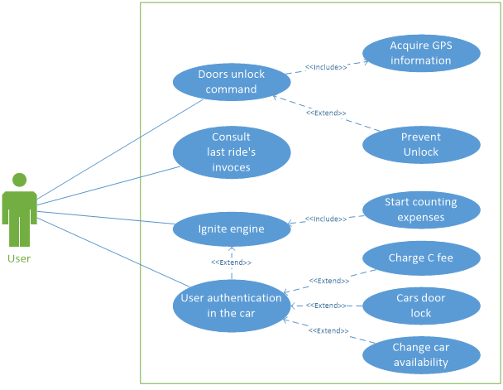
Use Case Diagram: start ride
Notes:
Fee C: 1€/min if the user doesn’t authenticate himself and ignite the engine in 5 minutes from the car unlock

Slide 12
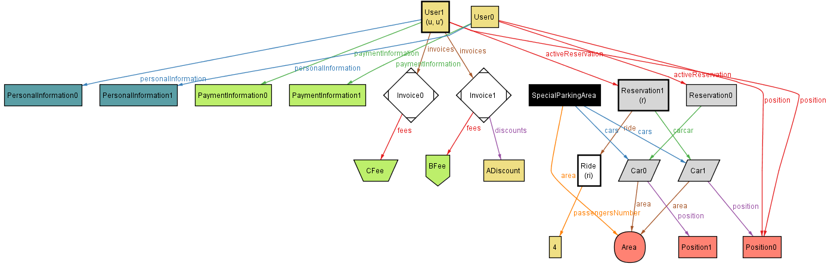
Alloy Modeling: start ride
Notes:
Fee C: 1€/min if the user doesn’t authenticate himself and ignite the engine in 5 minutes from the car unlock

Slide 13
Outline
Requirements Analysis
and
Specification Document
Goals
Project Planning
Function Points Analysis
Design Document
Architecture Overview
Proposed system
Actors
Scenario & Use Case
COCOMO II Analysis
Project Milestones
Risk Management
Architecture Patterns
Component View
Mockups
Integration Test Plan Document
Test Strategy
Dependencies Management
Notes:
Parlare dei pallozzi più grossi e spiegarne il motivo dell’ordine.
Ricordarsi di dire che comunque il PP parte assieme al RASD

Slide 14
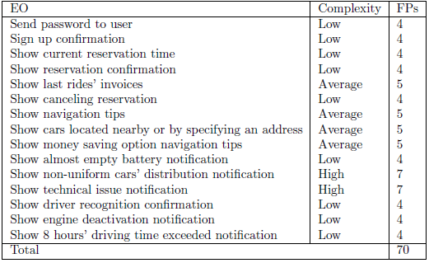
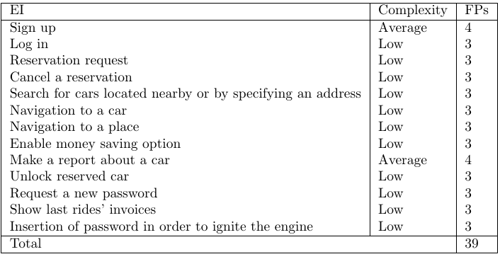
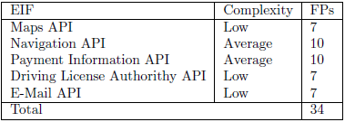
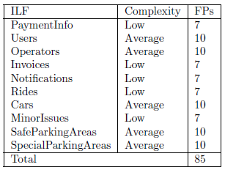
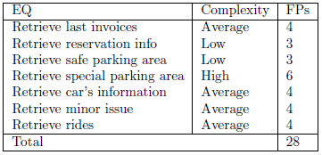
Function Points Analysis
Notes:
-External Outputs, External Inputs, External Interface Files, Internal Logic Files, External Inquiries
- EO should be provided for few complex cases, but many cases in general. At the same time, many types of files are necessary to store info necessray for the system logic → HIGH IMPACT

Slide 15
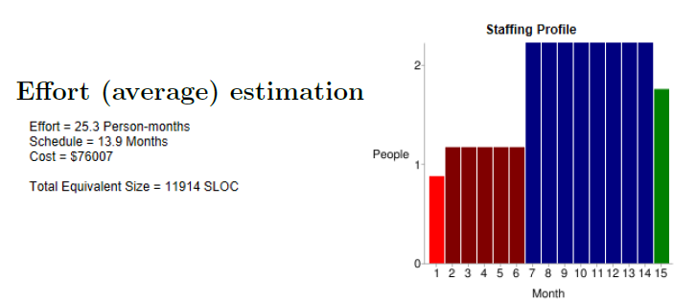
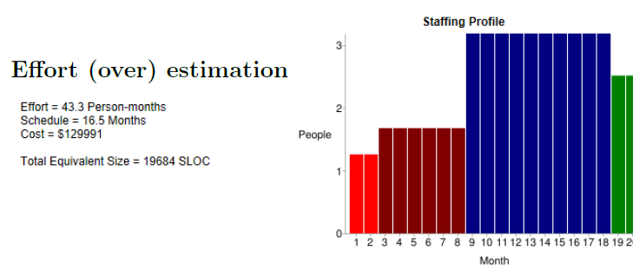
COCOMO II Analysis
Notes:
-We considered the average and oversized multiplier factors indicated by COCOMO as standard for JEE, then we considered the (AVERAGE) result divided for the 3 people that are assigned to the project, that is to be said, US.
-We thought that having also an oversized estimation of the required effort could be useful to give shape to REALISTIC DEADLINES

Slide 16
Project Milestones
16/10/2016
Project Start
9/11/2016
5/12/2016
DDv1 Release
22/5/2017
System Demonstration
1/6/2017
RASDv1 Release
System Release v1
26/6/2017
System First Start
Notes:
-We considered the average and oversized multiplier factors indicated by COCOMO as standard for JEE, then we considered the (AVERAGE) result divided for the 3 people that are assigned to the project, that is to be said, US.
-We thought that having also an oversized estimation of the required effort could be useful to give shape to REALISTIC DEADLINES

Slide 17
Risk Management
Risk | Strategy
Adversion of preexisting competitors | Accurate legal issues analysis
Public stakeholders | Accurate legal issues analysis
Dismission of exhaust batteries and broken pieces | Special contract for dismission in stocks
Possible delays of the project development | Flexible and incremental deadlines
Possible problems during the design of interaction with external elements | Object oriented development
Notes:
-Through a risk analysis we highlighted the main issues that could affect the duration of the project
-ACCURATE ANALYSIS OF THE ENVIRONMENTAL AND ECONOMICAL LEGISLATION is needed (experts must be included in the initial phase)
-A STRICT RESPECT OF SW ENGINEERING PRINCIPLES to avoid delays in the development
-Se ci dovessero essere ritardi non si assumono comunque altre persone perché porterebbe ad ulteriori ritardi

Slide 18
Outline
Requirements Analysis
and
Specification Document
Goals
Project Planning
Function Points Analysis
Design Document
Architecture Overview
Proposed system
Actors
Scenario & Use Case
COCOMO II Analysis
Project Milestones
Risk Management
Architecture Patterns
Component View
Mockups
Integration Test Plan Document
Test Strategy
Dependencies Management
Notes:
My name is Giuseppe and I’m going to present to you PowerEnJoy’s design of the software architecture.

Slide 19
Architecture Overview
Notes:
Here, we have the high level architecture concept for our system. We can notice that there is a Client/Server decomposition. Starting from the top of the slide we have the core system intranet. Inside the core system intranet there is an Application Server for managing the business logic for client’s requests, and a Web Server for generating web pages. Going further inside the back-end Server side’s architecture, we have a Database Server responsible for data management, and then the physical database storage with a backup storage.
Operator clients are physically located inside the net of the server and they are assumed to be part of the core system.
Exiting the core system intranet, we have a Proxy Server in a Demilitarized zone that acts as the front-end for the core system. It dispatches both incoming and outgoing requests. Since it is a front-end server, it is more prone to attacks, and hence we have two different kind of firewalls to protect it.
System clients are located differently from the core system. However, there is the necessity to have them logically inside the core system. For this reason, we have thought of an extranet (Virtual Private Network), which is connected to the core system through the Internet.
Finally, we have customer clients, which access the system features through the Internet.

Slide 20
Architecture Patterns (1)
Client/Server
Availability
Reliability
Robustness
Maintainability
Security
Performance
Scalability (horizontal)
Recovery from disasters
Portability
Notes:
Availability: concerns system up time (considering also the too much long time to repair) in an interval (The probability that a component is
working properly at time t)
Reliability: concerns a failure event in an interval (The probability that a component has always been working properly during a time interval (0,t))
Robustness: continuing running even though there are errors
As pointed out in the high level architecture concept, we have a Client/Server decomposition.
This architectural pattern allows us to gain some interesting nonfunctional requirements, such as availability, reliability, robustness and maintainability. In fact, there will be a team that will monitor the behavior of the system core features, and will both recover the system in case of failure and look for pathological issues that affect the system. Fixes to the server side will reflect on the entire system.
Client/Server guarantees more secure infrastructure as all sensitive data is stored in the back-end and is accessible only via special authorizations.
Horizontal scalability is achieved just adding more server machines since the Proxy Server has the function of load balancer.
Recovery from disasters is possible since all data is replicated in a different place.
Client software is made portable in order to “write once, run everywhere”, which is BTW the famous Java slogan.

Slide 21
Architecture Patterns (2)
Publisher/Subscriber
Broadcast dispatch of notifications to operators
Notification dispatcher considered as a publisher
Operators subscribed to the publisher through the login
Notes:
We used for a subpart of our system the Publisher/Subscriber architecture pattern. In particular, for broadcast dispatch of notifications to operators. Indeed, notification dispatcher has to be considered as publisher and operators, once logged in, are the subscribers.

Slide 22
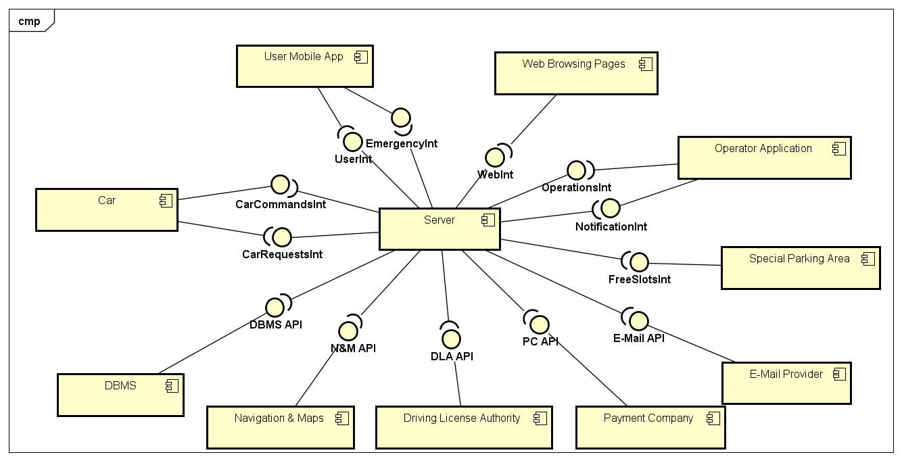
Component View
Notes:
Approcci utilizzati: partendo da questo component abbiamo utilizzato un approccio top-down per evidenziare i main component di ogni elemento. Una volta evidenziati i main component abbiamo utilizzato un approccio a sandwich.
Here, we have the high level component view for our system. Please notice that in the bottom of the scheme all external components and how they interface with the server main component.
Then, we have cars with interfaces for managing both incoming commands and outgoing requests or sensor data.

Slide 23
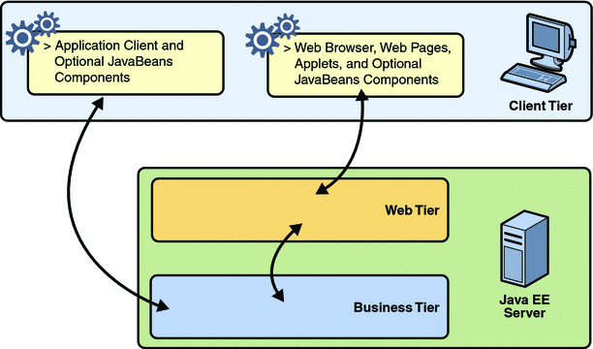
Deployment View
Notes:
It is important to highlight the possibility for clients to interface with the server following two possible paths. One regards the web browsing pages, which interact with the Web Tier and then, eventually the Web Tier uses business logic of the Business Tier. The other concerns the possibility of directly interfacing with the Business Tier if the client runs an application.

Slide 24
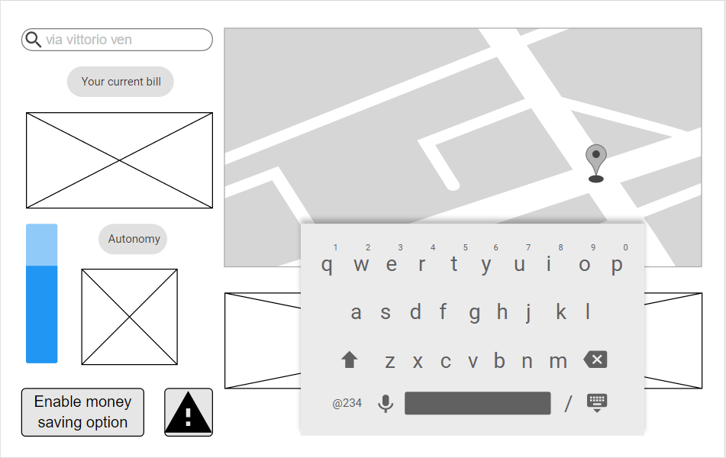
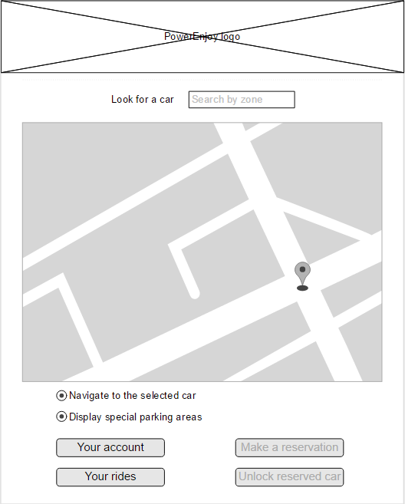
Mockups
Car Screen
Mobile App
Notes:
Here are presented two of the main mockups in which we can highlight the possibility for the driver to constantly check for the current bill and the battery level using the Car Screen.
In the mobile app we have, for instance, the possibility to navigate to a car or consult last invoices.

Slide 25
Outline
Requirements Analysis
and
Specification Document
Goals
Project Planning
Function Points Analysis
Design Document
Architecture Overview
Proposed system
Actors
Scenario & Use Case
COCOMO II Analysis
Project Milestones
Risk Management
Architecture Patterns
Component View
Mockups
Integration Test Plan Document
Test Strategy
Dependencies Management
Notes:
-Test strategy and dependencies management are the main topics to be faced in this section

Slide 26
Test Strategy
Bottom-up
Car Server Side
Car Client Side
Operator Server Side
User Mobile App – Web Browsing Pages Server Side
Notes:
To better discern the different parts of the system we identified the four sub-systems shown in the slide.
1. Car Server Side: functionalities and configurations of the cars, as well as their system logic
2. Car Client Side: handles driving decisions dictated by the server, as well as sensors and user interface
3. Operator Server Side: business logic of the operator
4. User Mobile App: business logic concerning the customers
-For each of them Bottom-up approach: we started from integration of PAIRS OF SINGULARLY TESTED MODULES, going up till reaching the integration of the whole system.

Slide 27
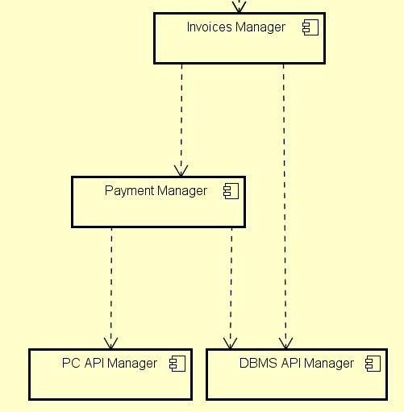
Dependencies Management
Notes:
To better discern the different parts of the system we identified the four sub-systems shown in the slide.
1. Car Server Side: functionalities and configurations of the cars, as well as their system logic
2. Car Client Side: handles driving decisions dictated by the server, as well as sensors and user interface
3. Operator Server Side: business logic of the operator
4. User Mobile App: business logic concerning the customers
-For each of them Bottom-up approach: we started from integration of PAIRS OF SINGULARLY TESTED MODULES, going up till reaching the integration of the whole system.

Slide 28
References
RASDver1.1
DDver1.1
ITPD
PP
For further references refer to the complete documents.

Slide 29
THANK YOU FOR THE ATTENTION

